Slide 1
CCS4354 · TENSORS AND GRAPHS
Graph Neural Networks for
Node Classification
A comparative study of GCN and GAT on the OGBN-Arxiv citation network
Gruop Members-23UG1-0061,23UG1-0095,23UG1-0054,23UG1-0095
Supervised by [Dr. Chameera De Silva ] · SLTC Research University

Slide 2
OVERVIEW
What we'll cover
01
02
03
04
Dataset & Tensor Foundations
Graph Representation & Preparation
Model Architecture & Training
Results & Explainability
OGBN-Arxiv structure and core tensor operations
Structural analysis and preprocessing decisions
GCN and GAT design, loss, and optimization
Evaluation metrics, embeddings, and attention analysis
02

Slide 3
INTRODUCTION
The OGBN-Arxiv Citation Network
Every node is a research paper; every edge is a citation. Our task: predict each paper's subject category using its content and its place in the citation graph.
169,343
1,166,243
128
40
Nodes (papers)
Edges (citations)
Feature dimensions
Subject categories
Task: Node Classification -> predicting a paper's subject category (e.g. AI, Vision, Databases) from its features and citation neighbors.
Graph density: 0.000041 — extremely sparse, typical of real-world citation networks
03

Slide 4
SPEAKER 1 · FOUNDATIONS
Tensors: The Building Blocks
Creation & Indexing
Reshaping
Building tensors and slicing them — how node feature rows are accessed.
Rearranging dimensions without changing the underlying data.
Matrix Multiplication
Broadcasting
The core operation behind every graph convolution layer.
Applying operations across mismatched shapes efficiently.
Aggregation
GPU Acceleration
Sum / mean along a dimension — exactly how a GNN combines neighbor features.
Moving computation to CUDA for training at graph scale.
04

Slide 5
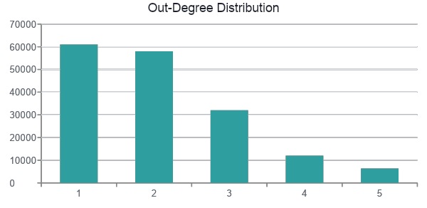
SPEAKER 2 · GRAPH STRUCTURE
Representing & Analyzing the Graph
edge_index format
edge_index[0] = [ 12, 45, 12, 90, ... ] (source)
edge_index[1] = [ 45, 88, 90, 3, ... ] (target)
A 2 x N tensor — each column is one citation: paper A cites paper B.
Density: 0.000041 - very sparse, as expected for citation graphs
Right-skewed degree distribution - a small number of highly-cited hub papers
Graph is largely one connected structure, with a few small isolated clusters
05

Slide 6
SPEAKER 2 · PREPARATION
Preparing the Data
Official OGB Split
Feature Normalization
Class Handling
Train / validation / test split by publication year - older papers train, newer papers test. Keeps results comparable to the OGB leaderboard and mirrors a realistic deployment scenario.
Feature magnitudes were already small and consistent across the 128 dimensions, so no additional normalization was applied - preserving the original semantic signal.
40 categories of unequal size -addressed at evaluation time using macro-averaged metrics rather than relying on raw accuracy alone.
06

Slide 7
SPEAKER 3 · ARCHITECTURE
Two Architectures, Two Strategies
GCN
GAT
Graph Convolutional Network
Graph Attention Network
Aggregation
Fixed, degree-normalized average of all neighbors
Aggregation
Learned attention weights per neighbor
Layers
3
Attention heads
8
Hidden dim
256
Hidden dim
32 per head (256 effective)
Activation
ReLU
Activation
ELU
Dropout
0.5
Dropout
0.5
07

Slide 8
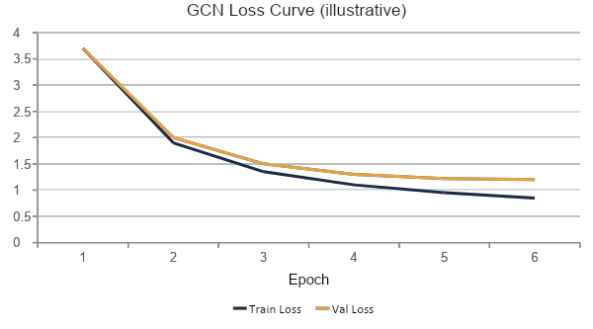
SPEAKER 3 · TRAINING
Training & Optimization
Loss & Optimizer
CrossEntropyLoss — standard for multi-class classification
Adam optimizer — adapts learning rate per parameter
GCN: lr = 0.01 | GAT: lr = 0.005 (lower, for attention stability)
weight_decay = 5e-4 for L2 regularization
Hyperparameter sweep (GCN, learning rate)
0.001 -> underfit · 0.01 -> best · 0.05 -> unstable
08

Slide 9
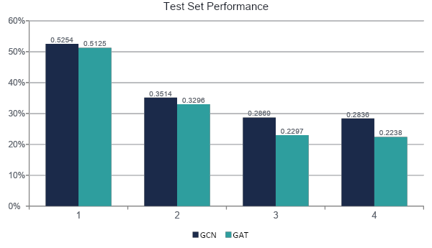
SPEAKER 4 · RESULTS
Model Evaluation
Macro-averaged
Precision, recall, and F1 use macro-averaging — treating all 40 categories equally, regardless of size, for a fairer picture on an imbalanced label set.
Takeaway
GCN edges out GAT on this benchmark — its simpler, fixed aggregation generalizes slightly better here, while GAT's added attention parameters likely need more epochs or tuning to pay off fully.
09

Slide 10
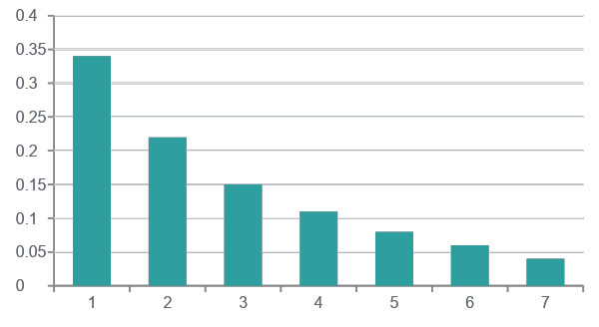
SPEAKER 4 · EXPLAINABILITY
Why Does the Model Decide This?
t-SNE Embedding Visualization
GAT Attention Weights
Clusters by category emerge in embedding space — even though clustering was never a direct training objective.
Not all citation neighbors are equal — GAT learns to weight some far more heavily than others.
10

Slide 11
DELIVERY
Graph Intelligence Dashboard
An interactive Streamlit app bringing every result into one place.
Live graph statistics — nodes, edges, density
streamlit run app.py
Model comparison table & chart (GCN vs GAT)
169,343 nodes · 1,166,243 edges · density 0.000041
Node-by-node prediction explorer
Model Accuracy F1
GCN 52.5% 28.4%
GAT 51.3% 22.4%
t-SNE embedding visualization
[OK] Node #0 — Correct prediction
11

Slide 12
CONCLUSION
What We Learned
Both models classify papers well above the ~2.5% random baseline for 40 classes
GCN's simpler, fixed aggregation slightly outperformed GAT on this benchmark
Embedding and attention analysis confirm the model's decisions are structurally meaningful, not a black box
Future Work
Deeper hyperparameter search across layers and dropout
A third architecture (GIN) for the bonus marks
GNNExplainer-based subgraph explanations
Larger-scale attention analysis across many nodes
12

Slide 13
TEAM
Individual Contributions
M1
M2
M3
M4
Member 1
Member 2
Member 3
Member 4
Tensor fundamentals notebook, dataset setup, presentation coordination
Graph representation & analysis, data preparation, split justification
GNN architecture design (GCN & GAT), training loop, hyperparameter tuning
Model evaluation, explainability analysis, Streamlit dashboard, report compilation
13

Slide 14
Thank You
Questions & Discussion
Group 07 · CCS4354 Tensors and Graphs · SLTC Research University

